Slide 1
LENDING CLUB CASE STUDY
SUBMITTED BY:
ASWANTH KUMAR V
MARY DIVYA ANUSHA YERUVA

Slide 2
AGENDA
Problem Statement
Data Understanding
Data Cleaning and Manipulation
Data Analysis
Plotting the Graphs
Observations and conclusion
Recommendations

Slide 3
Problem Statement
Lending Club is a marketplace for personal loans that matches borrowers who are seeking a loan with investors looking to lend money and make a return.
When the company receives a loan application, the company has to make a decision for loan approval based on the applicant’s profile. Two types of risks are associated with the bank’s decision:
If the applicant is likely to repay the loan, then not approving the loan results in a loss of business to the company.
If the applicant is not likely to repay the loan, i.e. he/she is likely to default, then approving the loan may lead to a financial loss for the company.

Slide 4
Data Understanding
Go through the problem statement clearly and understand the business requirement
Understand the columns with given dictionary data and the usage of the columns
Compare the columns with the relevant columns to get more clarity
From the data set explore the data by looking at sample data by filtering few columns
Ignore the columns having none values which makes understanding the data is easier
Finding out the data quality issues in the data set
Filtering out the special characters and spaces which blocks your data transforming
Finding out the columns having yes unique item or categories makes filtering out the other columns easier to understand the data much better

Slide 5
Data Cleaning and Manipulation
Checking the percentage of Nan values in dataset.
Dropping the Columns having greater or equal to 75% Nan values.
Dropping the columns which are having unique data.
Finding the columns having unique data
Sorted unique values based on the columns.
Dropping the unnecessary columns as per the column's data uniqueness.
Dropping the columns which are not required for the data analysis (Customer behavior)
Dropping the rows home_ownership is having NONE values
Dropping the rows home_ownership is having Other values
Dropping the rows loan_status is having Current Value

Slide 6
Contd..
Removing the % from int_rate column(eg: 13% as 13)
Converting the term column to integers ( eg: 36 months as 36)
Formatting issue_d
converting installment column to int
Approved ratio of loan amount (funded_amnt_inv/loan_amnt)*100
Manipulating the subgrading to numeric values for better visualization
emp_length column modification
emp_length column modification to number of years ( eg: 6 years as 6)
Filling the empty cells of emp_length with 0
If emp lenght is less than 1 year round off to 0
If emp lenght is greater than 10 years round off to 10
revol_util column data modification
Removing the % from revol_util column
revol_util column is customer behavior column can be removed if not required

Slide 7
Data Analysis
The objective is to identify predictors of default so that at the time of loan application, we can use those variables for approval/rejection of the loan.
Data Analysis can be performed-
Univariate Analysis
Bivariate Analysis
Multivariate Analysis
There are broadly three types of variables –
Those which are related to the applicant (demographic variables such as age, occupation, employment details etc.),
Loan characteristics (amount of loan, interest rate, purpose of loan etc.) and
Customer behavior variables (those which are generated after the loan is approved such as delinquent 2 years, revolving balance, next payment date etc.).

Slide 8
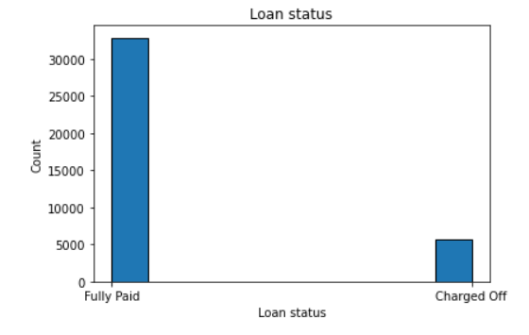
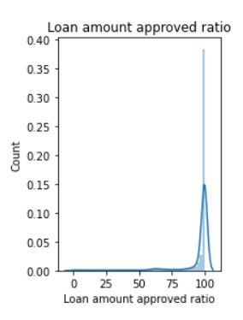
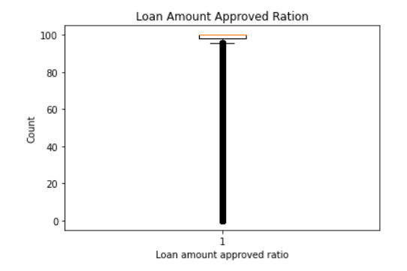
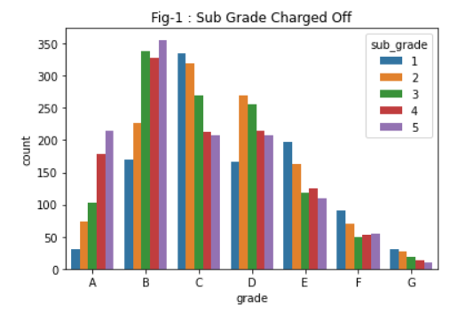
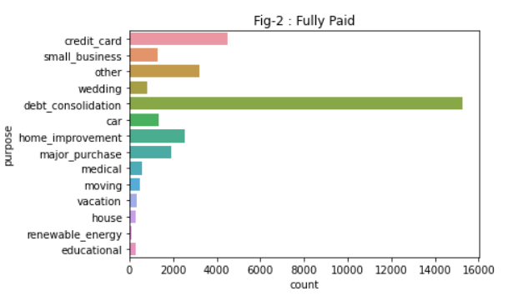
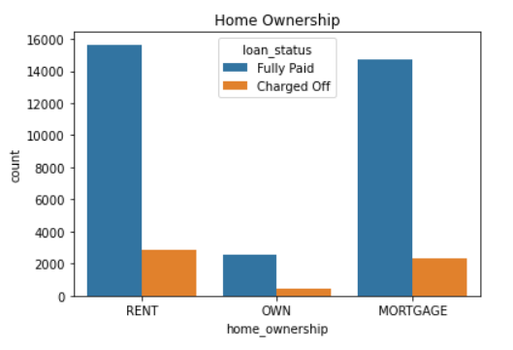
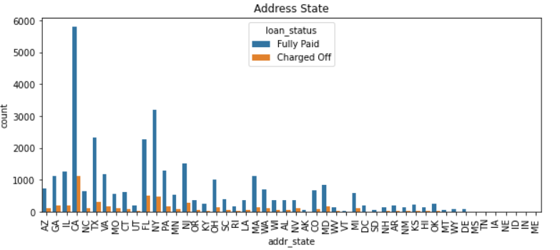
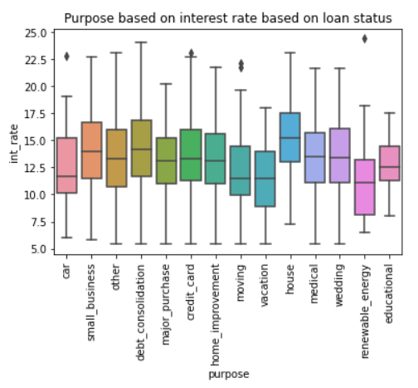
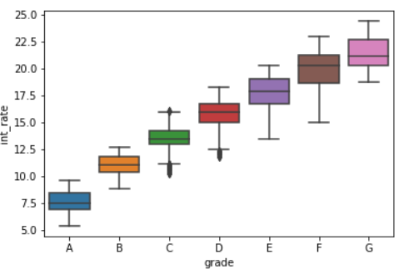
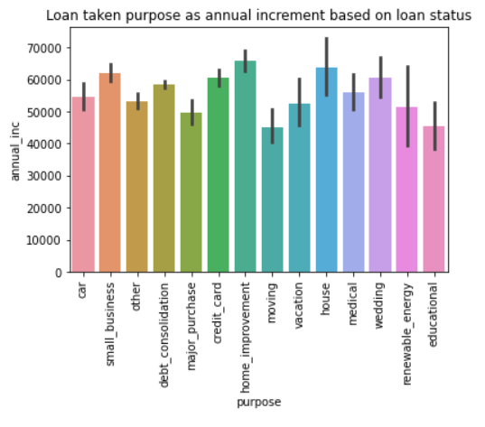
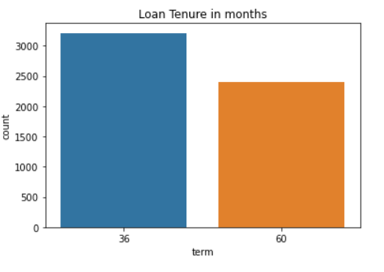
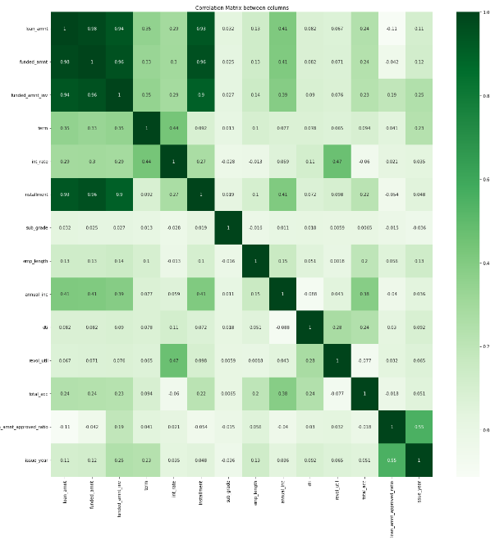
Plotting the Graphs

Slide 9
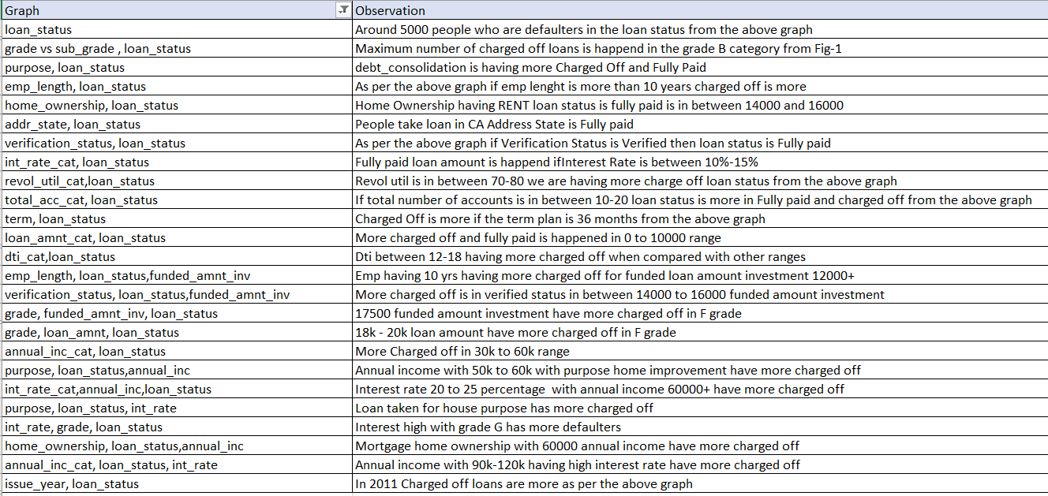
Observation and conclusion

Slide 10
Recommendations
Verification of employment proof of loan applicant.
Reduce loan approval for Rent category in home ownership. Because it has higher rate in charge off.
Proper investigation and verification on the Rent category home ownership before giving loan approval.
Avoid approving loans for grade B and Sub Grad B, C
Do proper inquiry for Grade B,C,D and Sub Grad A, B, C
Avoid approving loans for sub grade B.
Applications who take loan on debit consolidation purpose are likely to be charge off
The purpose of loan is lesser than annual income range have a proper verification
Applicant annual income range greater than 60k request to recommendation highly for this category
A mortgage home ownership required strict enquiry

Slide 11
THANK YOU

